Slide 1
Maps and Schedule for Astro 25 – Summer ‘18
Chimney Peak Wilderness Campground

Slide 2
Field Trip Schedule
Friday - Jul 13
* 6:00pm - I'll plan to arrive and meet you at the campground. I'm flexible on when you arrive - it's a long drive - 6 hrs and 320 miles. Some of you may not be able to leave early. BUT, if anyone CAN leave early, even a day early, that would be fantastic so they can make sure we have a good spot.
* 7:30pm - dinner: pasta and romaine salad with home-made dressing, sourdough bread
* 8:30pm Observing session under the darkening sky; summer Milky Way explorations, we'll have at least 2-3 telescopes, and big binoculars
* 10:30pm - micro-lecture on the upcoming Christa Occultation , which happens in one hour. Celestron scope will be then outfitted with video timing gear. Star charts to locate the target star will be passed out to the other scopes. Students (with instructor help) will decide who will do what duties: smart-phone operation, at-the-eyepiece observation and practice session. The event is just before midnight!
* Midnight - discuss results, review video recording
Saturday - Jul 14
* 7:30am - begin prep for breakfast. French Crepes! Feel free to have brought along anything from the fridge to donate to the cause (fruit, sour cream, sweets...). If possible let me know ahead of time so I can do smarter shopping on the drive down
* 9:30am - Breakfast should be wrapping up, and we'll have Kirk (aka "Cap'n Kirk") helping us with solar filtered telescope viewing of the sun. I'll micro-lecture on the sun
* 10:45am or so - we'll plan to begin our hikes and explorations. I'm still planning exactly what spots we want to go to. Options include doing the archeo-astronomy site in the Lamont Meadow area (if not today, then definitely Sunday on the return drive, before getting to Remington Hot Springs), then to the Kern River above Lake Isabella. Or we could hike part of the Pacific Crest trail for larger views and geology lectures involving the larger Sierra and Basin and Range desert region.
* by 5:30pm - Return to camp, some rest and relaxation time as I start to prepare for dinner.

Slide 3
Sunday - July 15
* 7:30am - Breakfast prep, eating by 8am. Cowboy toast, black beans and veges, burrito wraps, scrambled eggs
* 9:00am - Micro lecture nearby on planetary processes
* 10:30 am - be packed up
* 10:30am or so, Start drive down from camp, down to Remington Hot Springs (~40 min drive) for our final official session. Short but steep hike down to the river and springs. Enjoy the hot springs, enjoy cold dips in the Kern River bordering the hot pools. Last micro-lectures.
Remington Hot Springs is not commercial, just a lovingly constructed set of hot pools from natural hot springs. It's a popular place and expect we'll have to share the pools with others. Be friendly and neighborly!
After we're officially done with the last lecture, I'll hand out the take-home final exams and give instructions, and then you're free to have a good trip back to Santa Cruz.

Slide 4
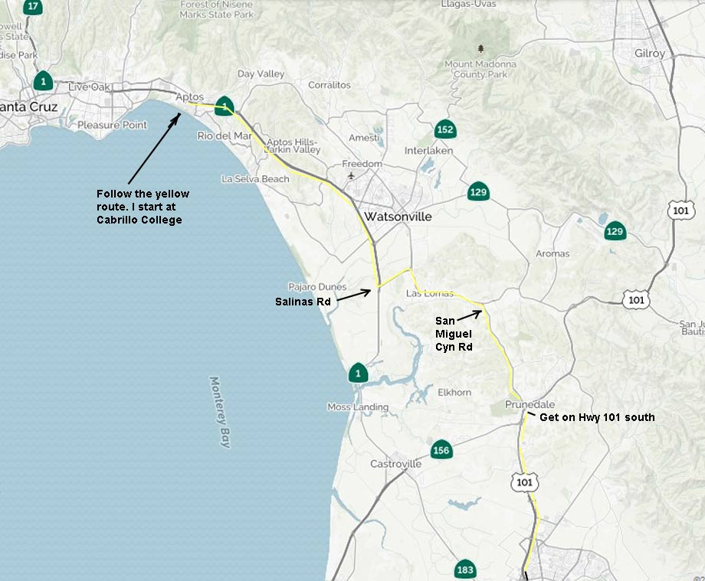
Take Hwy 1 to Salinas Rd, then angle right onto Hall Rd and right through Las Lomas, turn right at San Miguel Cyn Rd to Prunedale and Hwy 101 and drive south on Hwy 101

Slide 5
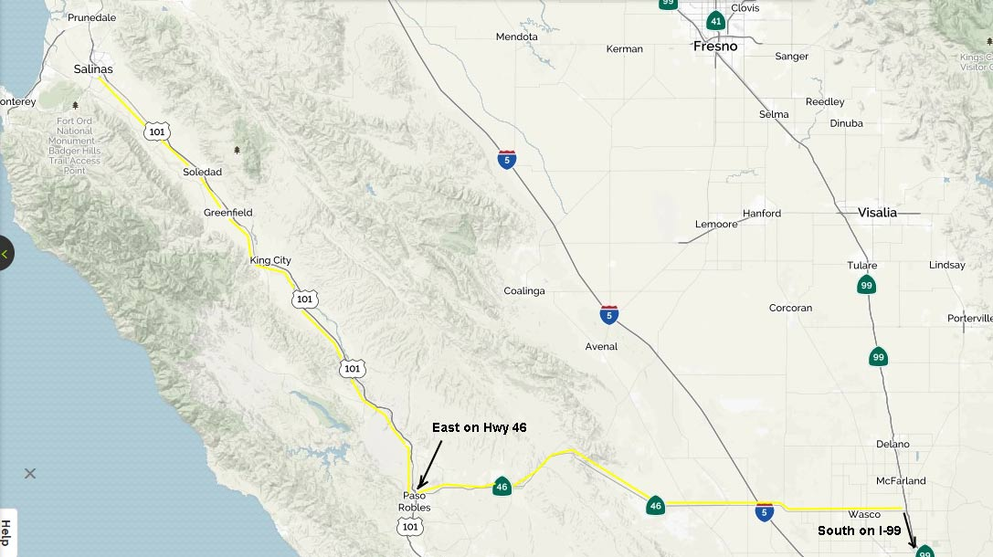
At Paso Robles, get on Hwy 46 East, stay on it, passing over Lost Hills and I-5, through Wasco, to I-99 and go south on I-99 to Bakersfield

Slide 6
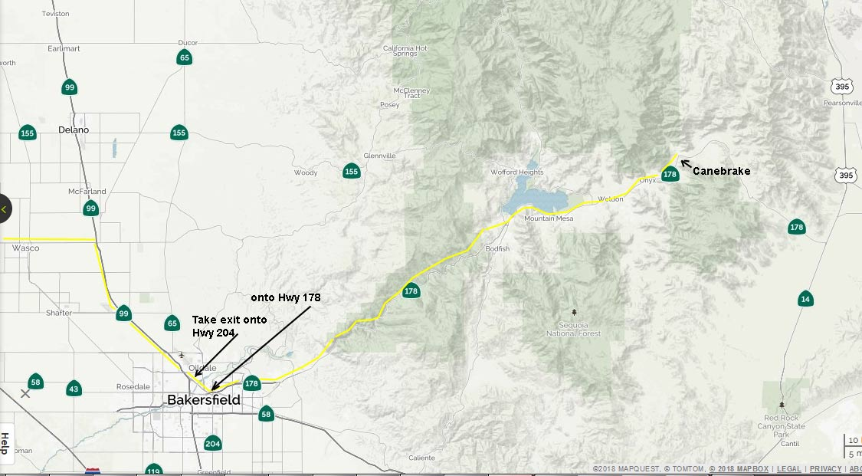
Look for exit onto Hwy 204, then merge onto Hwy 178 and stay on it into the mountains. Be sure you pass Lake Isabella with the lake on your LEFT

Slide 7
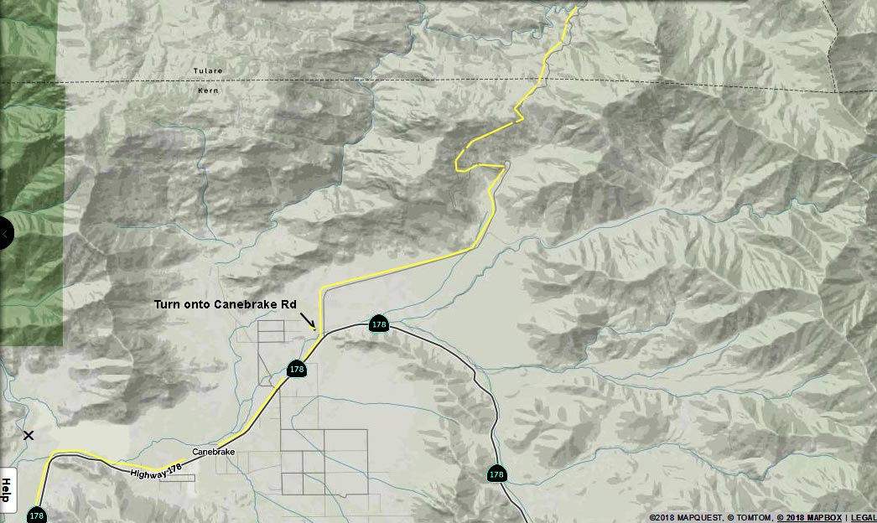
Watch for sign for “Chimney Peak Wilderness” on the left. That’s Canebrake Rd.

Slide 8
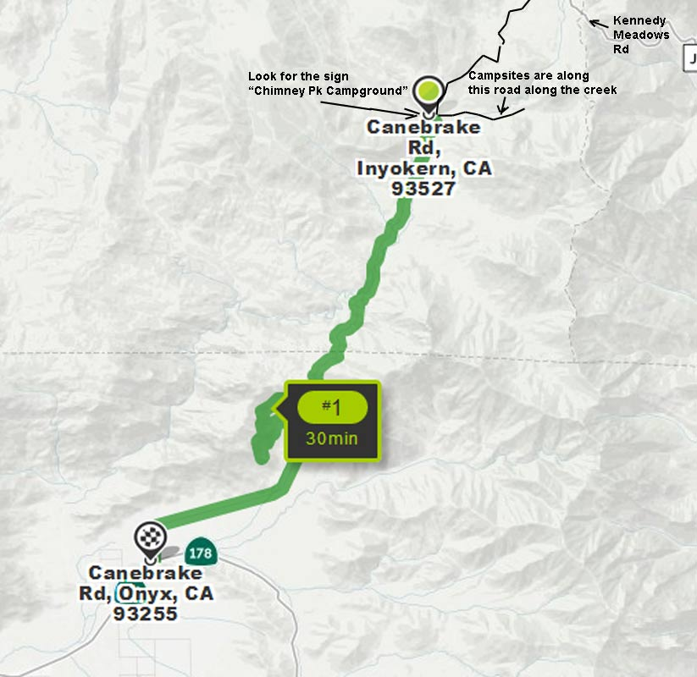
10.8 miles up Canebrake Rd you’ll be in a small valley and an obvious sign on your right says “Chimney Peak Campground”.

Slide 9
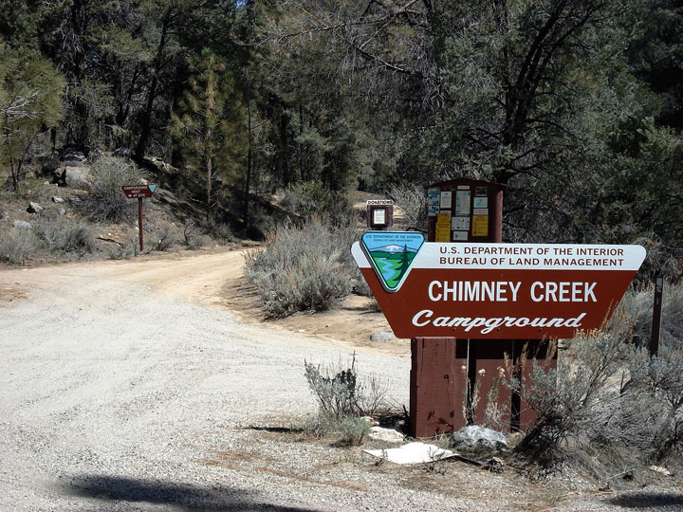
Here’s the turnoff sign, into the campground

Slide 10
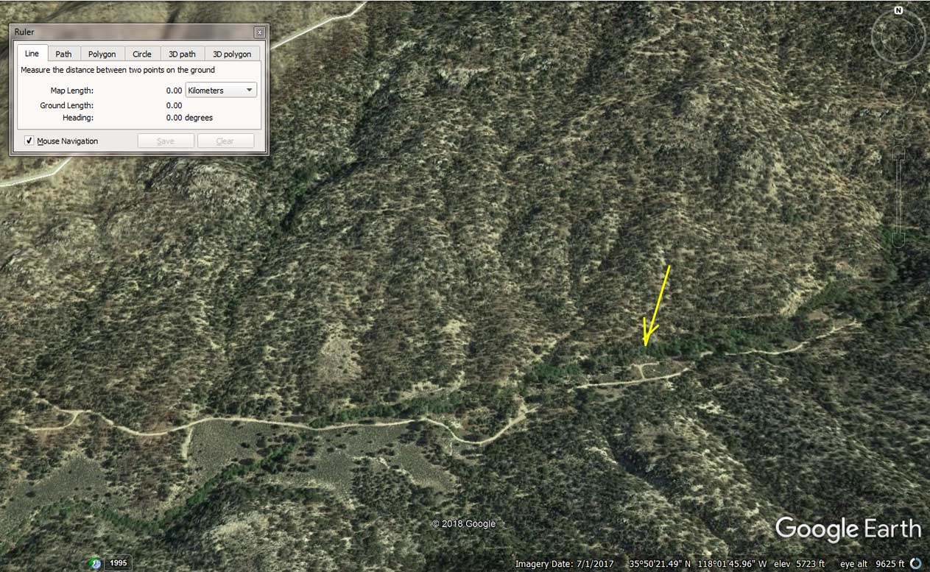
Campsites are along this road. If you get there early, grab some! Look for a red van, and/or the Cabrillo white van

Slide 11
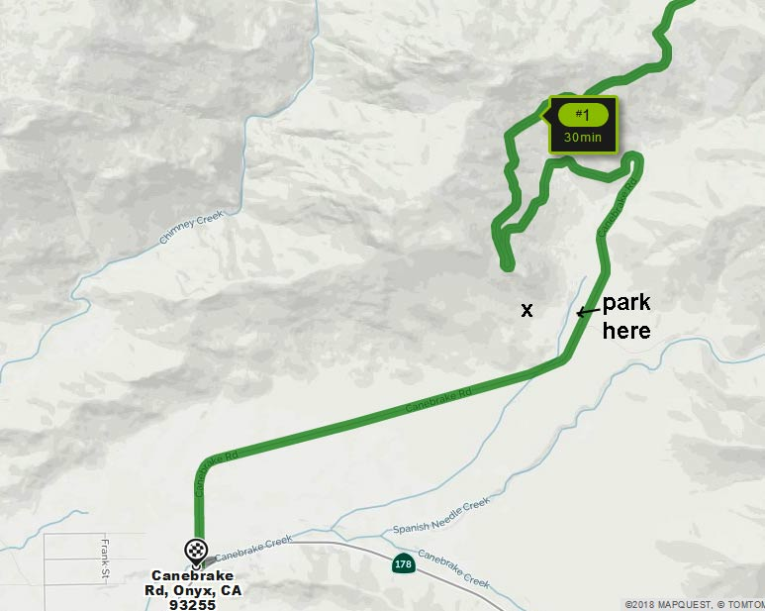
Ancient Native American pictographs, obsidian, maybe archeo-astro too? “X”. Amongst giant granite boulders. Let’s search for all we can find. Scan horizon for where the solstice points would be

Slide 12
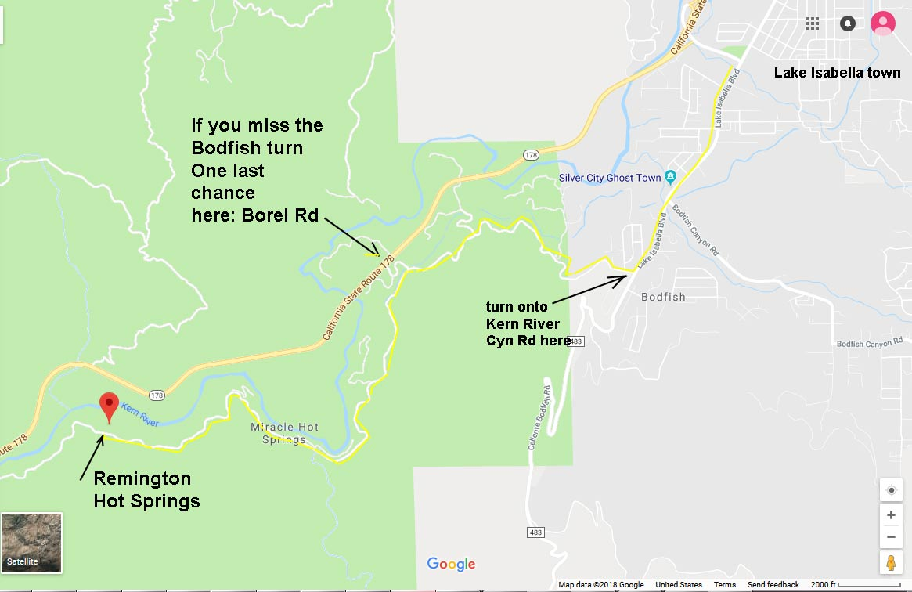
Driving back, after Lake Isabella get on Lake Isabella Blvd to Bodfish, right turn onto “the old road”= Kern River Canyon Rd. It’s maybe 3 miles down. Parking area will take enough cars, but not marked. Look for Cabrillo van, if we get separated!

